Slide 1
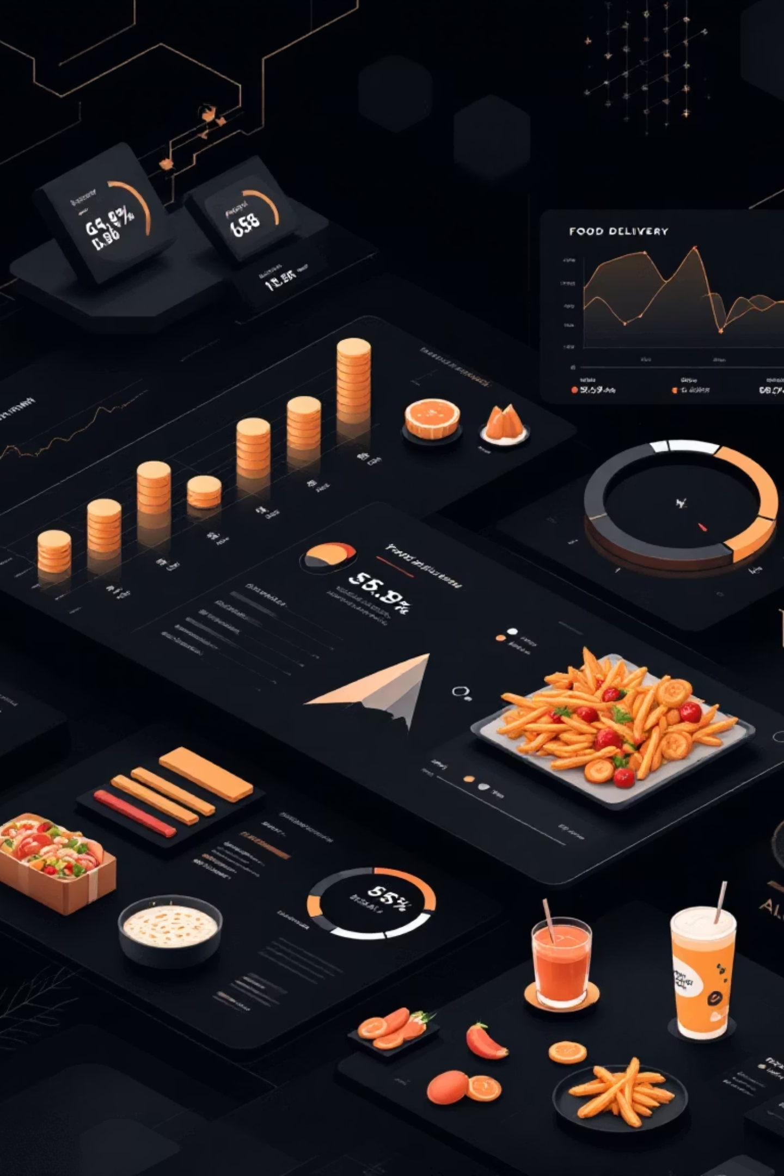
Zomato Analytics Dashboard
A comprehensive analysis leveraging Excel, Tableau, Power BI, and SQL to unlock insights from restaurant and delivery data.

Slide 2

TEAM MEMBERS
MRUNMAI VINAYAK DEVLEKAR
VISHAL KUMAR
SHUBHAM KISHOR PETHE
ROHAN KHILARI

Slide 3
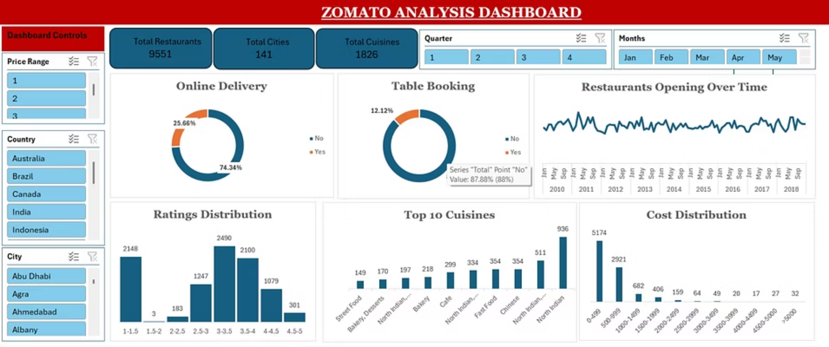
Excel Dashboard Analysis

Slide 4
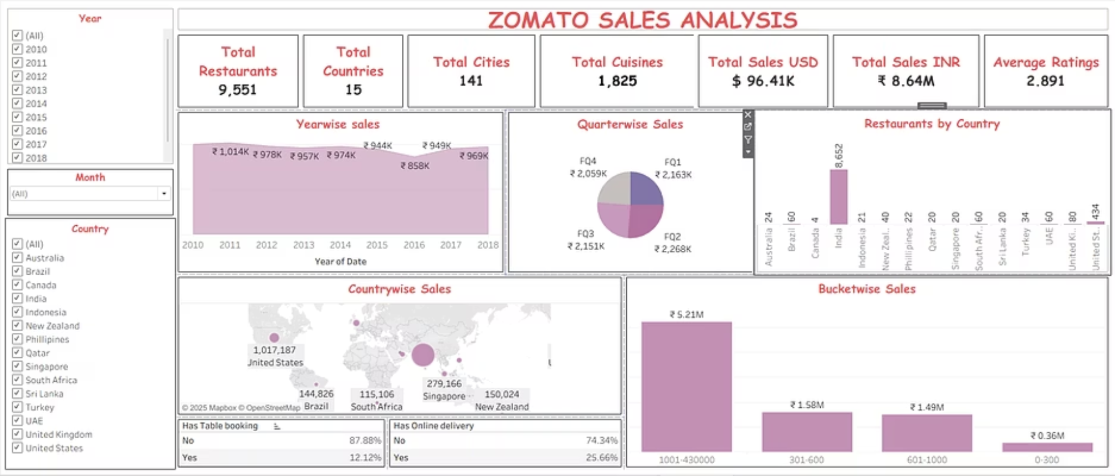
Tableau Dashboard Analysis

Slide 5
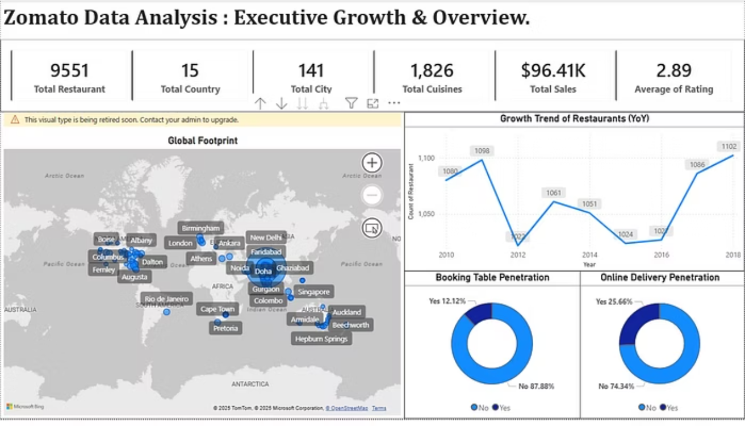
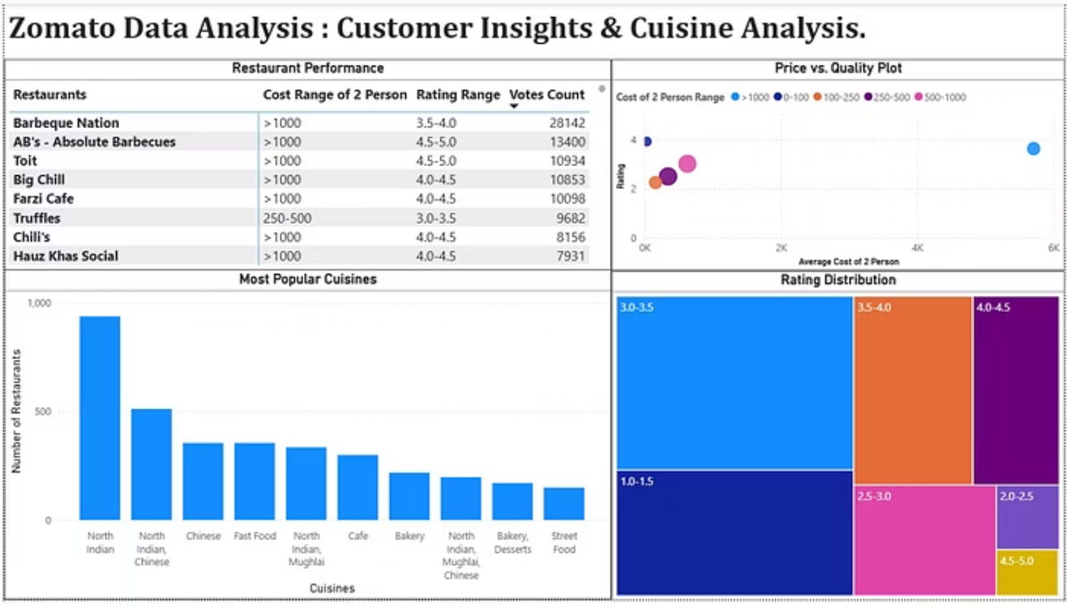
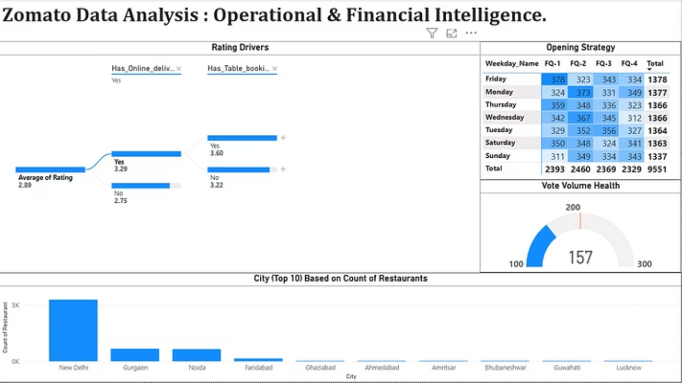
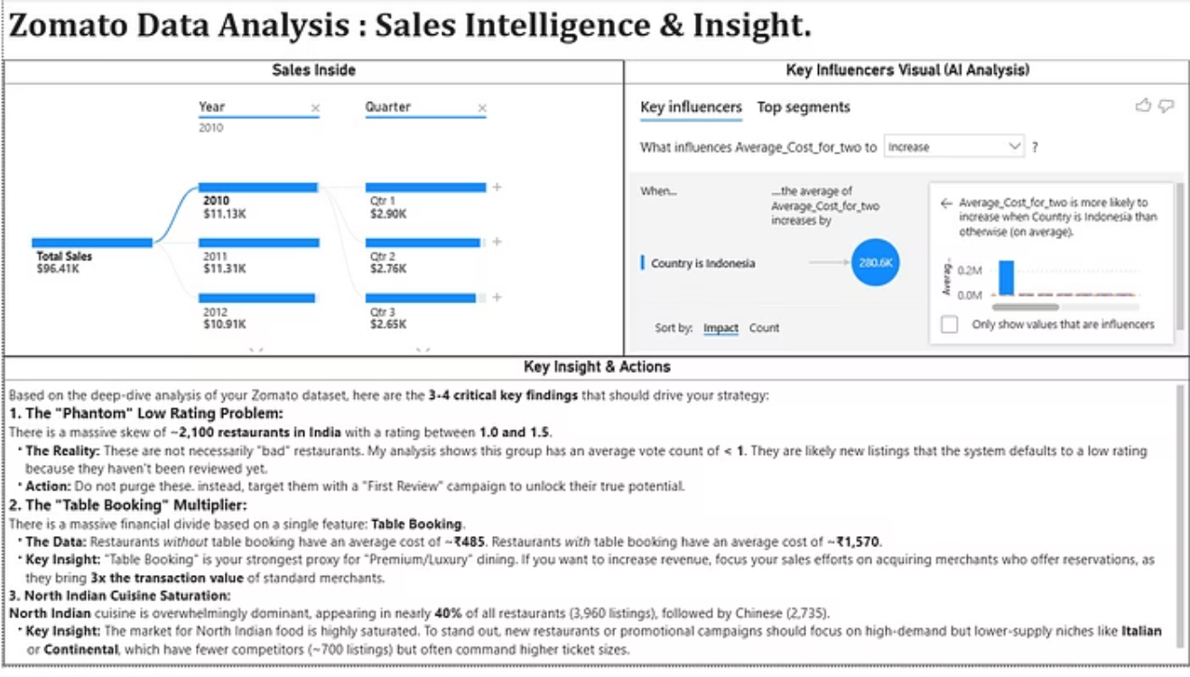
Power BI Dashboard Insights

Slide 6
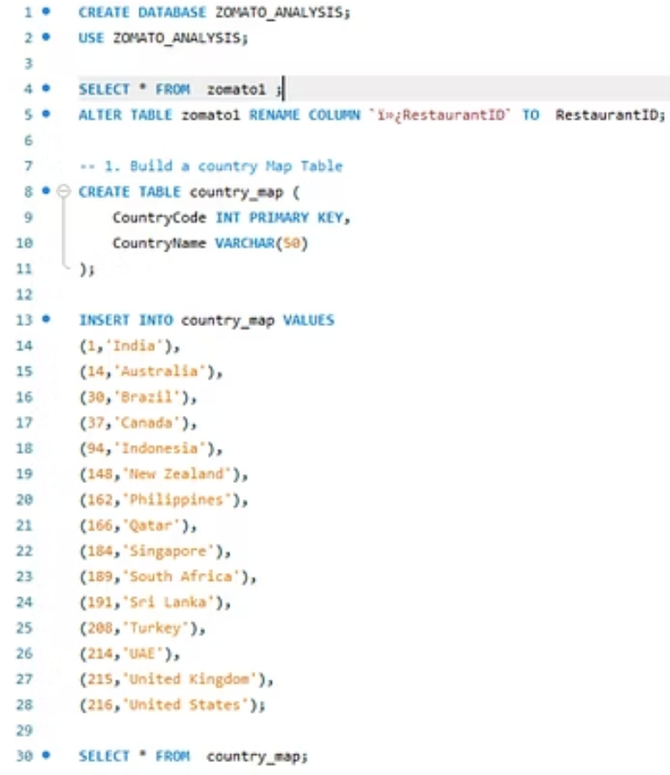
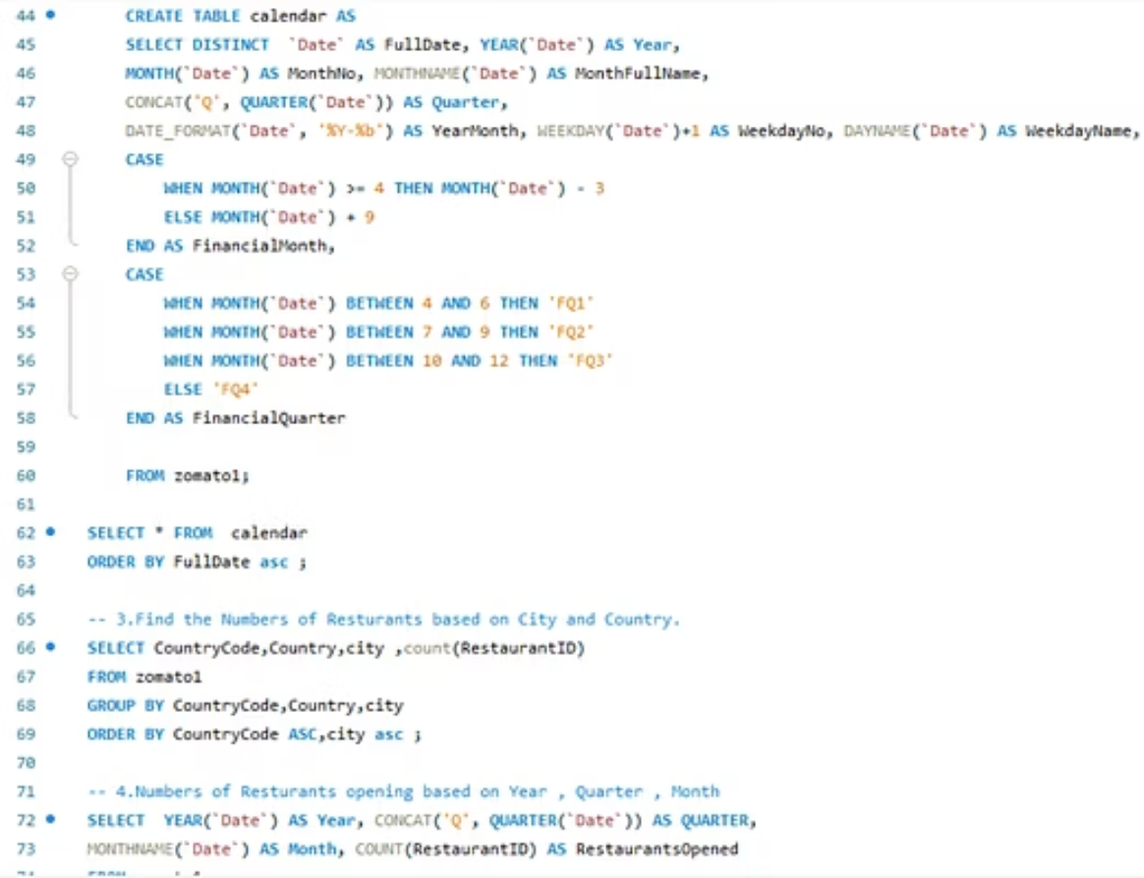

SQL Query Analysis

Slide 7









Key Findings & Insights
Restaurant Performance
Top 20% restaurants generate 65% of revenue; ratings above 4.2 see 3x more orders
Delivery Optimization
Reducing delivery time by 5 mins increases customer retention by 18%
Customer Behavior
Repeat customers (42%) contribute 71% of orders; loyalty programs show 25% lift
Growth Opportunities
Tier 2 cities show 45% YoY growth potential; untapped market worth ₹340M
Strengthen International Markets
India and U.S. show high sales; targeted campaigns can further improve revenue.
Boost Online Delivery Adoption
With only 25% usage, delivery-focused offers, partnerships, and UX improvements can grow this segment.
Capitalize on Premium Customers
Since the highest revenue comes from premium buckets, onboarding more high-end restaurants can increase profits.
Improve Mid-Period Performance
Yearwise dips around 2015 suggest room for customer retention and engagement strategies.
Expand in High-Restaurant Countries
India has a massive restaurant base; optimizing listings can increase sales per restaurant.

